Slide 1
Macroeconomics ECON 101
Trade-offs, Comparative Advantage, and the Market System
(Chapter 2)
Instructor: Muhebullah Karimzada
Notes:
If this PowerPoint presentation contains mathematical equations, you may need to check that your computer has the following installed:
1) MathType Plugin
2) Math Player (free versions available)
3) NVDA Reader (free versions available)

Slide 2
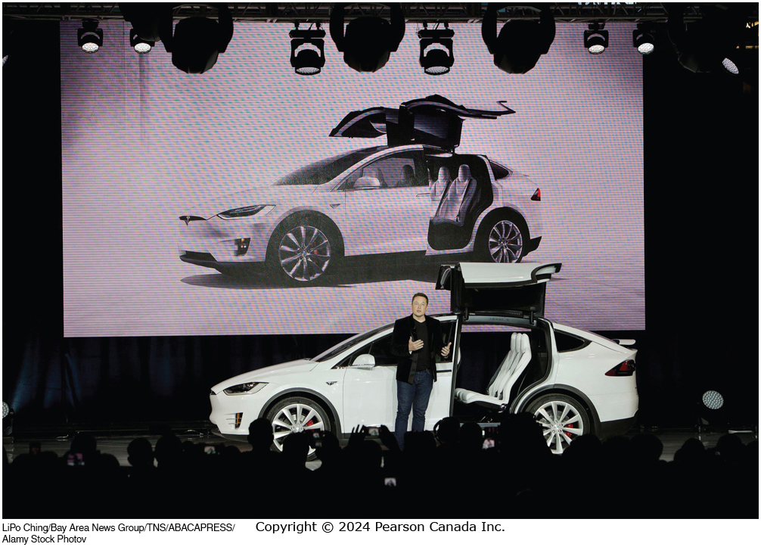
Chapter Outline
2.1 Production Possibilities Frontiers and Opportunity Costs
2.2 Comparative Advantage and Trade
2.3 The Market System

Slide 3
Scarcity and Trade-offs
People continually face decisions about how best to use their scarce resources.
Scarcity: a situation in which unlimited wants exceed the limited resources available to fulfill those wants.
Scarcity requires trade-offs. Economics gives us tools to help make trade-offs wisely.
Example: When deciding how to use its scarce workers and machinery, if Tesla wants to produce more Model 3s, those resources will not be available to produce other models.

Slide 4
Production Possibilities Frontiers and Opportunity Costs
2.1 Learning Objective
Use a production possibilities frontier to analyze opportunity costs and trade-offs.
A production possibilities frontier (PPF) is a curve showing the maximum attainable combinations of two goods that can be produced with available resources and current technology.
Is the PPF a positive or normative tool?
Positive; it shows “what is,” not “what should be.”

Slide 5
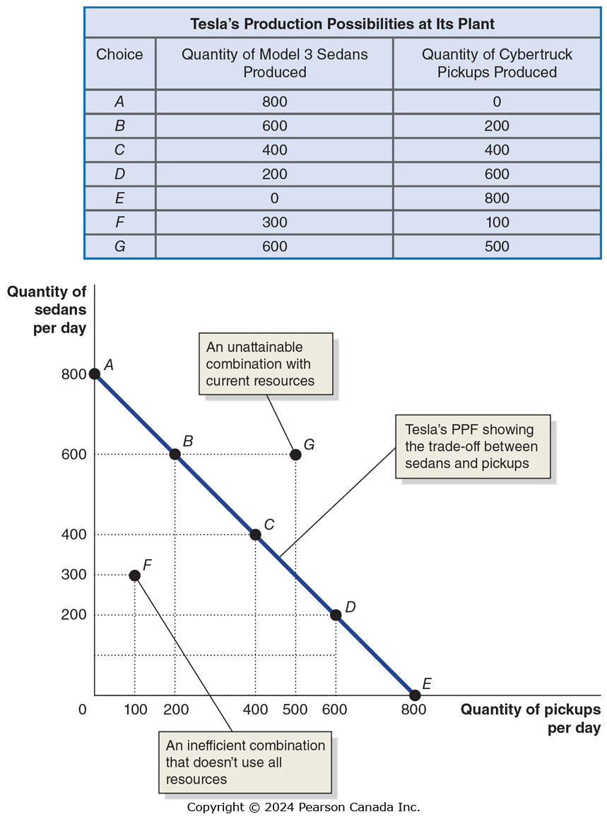
Figure 2.1 Tesla’s Production Possibilities Frontier (1 of 2)
Tesla can produce its Model 3 Sedans, or its Cybertruck Pickups.
Producing more Cybertruck Pickups requires reducing the number of Model 3 Sedans produced.
Points on the P P F are attainable for Tesla.
Points below the curve are inefficient.
Points above the curve are unattainable with current resources.

Slide 6
Figure 2.1 Tesla’s Production Possibilities Frontier (2 of 2)
To produce 200 more Cybertruck Pickups (e.g. moving from point A to B), Tesla must produce 200 fewer Model 3 Sedans.
The 200 fewer Model 3 Sedans is the opportunity cost of producing 200 more Cybertruck Pickups.
Opportunity cost: The highest-valued alternative that must be given up to engage in an activity.

Slide 7
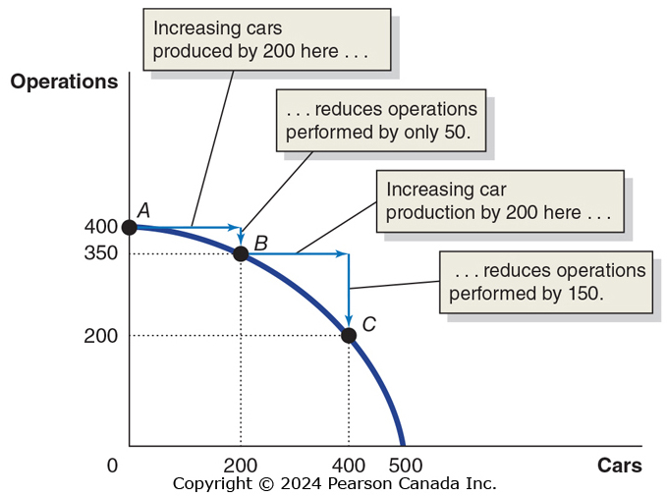
Figure 2.2 Increasing Marginal Opportunity Costs
On the previous slide, opportunity costs were constant.
But opportunity costs are often increasing.
Why? Some resources are better suited to one task than another. The first resources to “switch” are the one best suited to switching.
The more resources already devoted to an activity, the smaller the payoff to devoting additional resources to that activity.

Slide 8
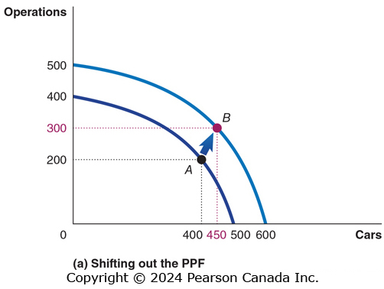
Figure 2.3 Economic Growth (Panel (a))
As more economic resources become available, the economy can move from point A to point B, producing more tanks and more automobiles.
Shifts in the production possibilities frontier represent economic growth.
Economic growth: The ability of the economy to increase the production of goods and services.

Slide 9
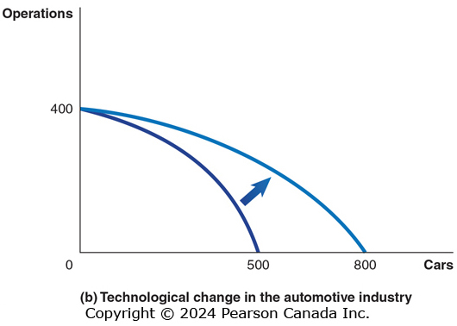
Figure 2.3 Economic Growth (Panel (b))
This panel shows technological improvement in the automobile industry.
The quantity of operations that can be produced remains unchanged.
With the improvement in technology in one industry, many previously unattainable combinations are now attainable.

Slide 10
Comparative Advantage and Trade
2.2 Learning Objective
Understand comparative advantage and explain how it serves as the basis for trade.
You and your neighbour each have a limited time to pick apples and/or cherries.
The table shows the amount of each fruit that you could each pick, by devoting all of your time to that fruit.
Blank | You | You | Your Neighbour | Your Neighbour
Blank | Apples | Cherries | Apples | Cherries
Devote all time to picking apples | 20 kg | 0 kg | 30 kg | 0 kg
Devote all time to picking cherries | 0 kg | 20 kg | 0 kg | 60 kg

Slide 11
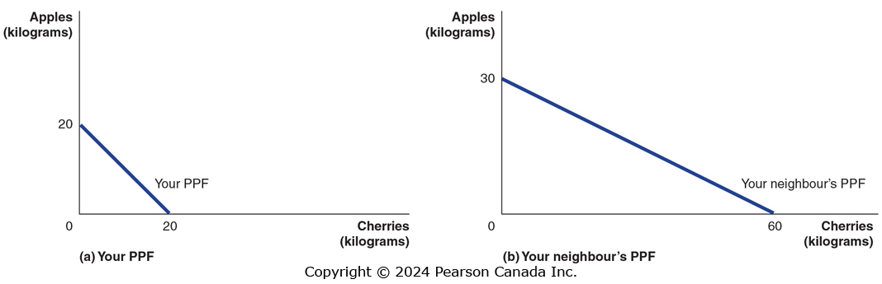
Figure 2.4 Production Possibilities for You and Your Neighbour, Without Trade (1 of 2)
If you spend all of your time picking cherries, you can pick 20 kilograms of cherries; or if you spend all your time picking apples, you can pick 20 kilograms of apples.
Your neighbour can similarly pick 60 kilograms of cherries or 30 kilograms of apples.

Slide 12
Specialization and Gains from Trade
What if you and your neighbour decided to specialize and trade?
Trade: The act of buying and selling.
Could your neighbour benefit from trade? She is better at picking both apples and cherries…
Both of you can benefit from trade by specializing in what you are relatively good at. Let’s see how…

Slide 13
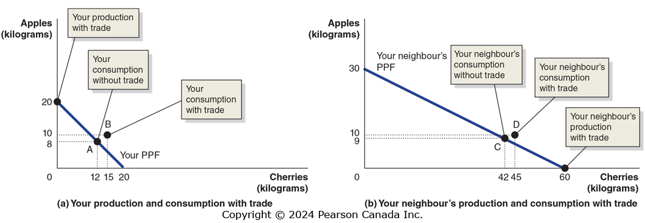
Figure 2.5 Gains from Trade (1 of 3)
Without trade, you pick and consume 8 kilograms of apples and 12 kilograms of cherries per week—point A in panel (a).
Your neighbour picks and consumes 9 kilograms of apples and 42 kilograms of cherries per week—point C in panel (b).

Slide 14
Figure 2.5 Gains from Trade (2 of 3)
If you specialize in picking apples, you can pick 20 kilograms. If your neighbour specializes in picking cherries, she can pick 60 kilograms.
If you trade 10 kilograms of your apples for 15 kilograms of your neighbour’s cherries, you will be able to consume 10 kilograms of apples and 15 kilograms of cherries— point B in panel (a).

Slide 15
Figure 2.5 Gains from Trade (3 of 3)
Your neighbour can now consume 10 kilograms of apples and 45 kilograms of cherries—point D in panel (b). You and your neighbour are both better off as a result of trade.
Note that your neighbour benefits from trade even though she could produce more of either fruit than you could.

Slide 16
Table 2.1 A Summary of the Gains From Trade
Blank | You | You | Your Neighbor | Your Neighbor
Blank | Apples (kg) | Cherries (kg) | Apples (kg) | Cherries (kg)
Production and consumption without trade | 8 | 12 | 9 | 42
Production with trade | 20 | 0 | 0 | 60
Consumption with trade | 10 | 15 | 10 | 45
increased consumption (Gains from trade) | 2 | 3 | 1 | 3
Both you and your neighbor are able to consume more with trade than without.

Slide 17
Explaining the Gains from Specialization and Trade
How could both of you benefit from trade when your neighbour was so much better than you?
Economists say your neighbour had an absolute advantage in both cherry and apple picking, but you had a comparative advantage in picking apples.
Absolute advantage: The ability of an individual, a firm, or a country to produce more of a good or service than competitors, using the same amount of resources.
Comparative advantage: The ability of an individual, a firm, or a country to produce a good or service at a lower opportunity cost than competitors.

Slide 18
Table 2.2 Opportunity Costs of Picking Apples and Cherries
Blank | Opportunity Cost of Picking 1 kg of Apples | Opportunity Cost of Picking 1 kg of Cherries
You | 1 kg of cherries | 1 kg of apples
Yourn | 2 kg of cherries | 0.5 kg of apples
The basis for trade is comparative advantage, not absolute advantage.
Individuals, firms, and countries are better off if they specialize in producing goods and services for which they have a comparative advantage and obtain the other goods and services they need by trading.
Notes:
Long description:
You: Opportunity cost of apples, 1 kilogram of cherries; opportunity cost of cherries, 1 kilogram of apples.
Your neighbor: Opportunity cost of apples, 2 kilograms of cherries; opportunity cost of cherries, 0.5 kilograms of apples.

Slide 19
The Market System
2.3 Learning Objective
Explain the basic idea of how a market system works.
A market is a group of buyers and sellers of a good or service, and the institution or arrangement by which they come together to trade.
Two key groups participate in the modern economy:
Households consist of individuals who provide the factors of production: labour, capital, natural resources, and other inputs used to make goods and services.
Households receive payments for these factors by selling them to firms in factor markets.
Firms supply goods and services to product markets; households buy these products from the firms.

Slide 20
The Four Factors of Production
Labour: All types of work, from the part-time labour of teenagers working at McDonald’s to the work of CEOs in large corporations.
Capital: Refers to physical capital, such as computers, machines, and buildings that are used to produce other goods.
Natural resources: Land, water, oil, iron ore, and other raw materials (or “gifts of nature”) that are used in producing goods.
An entrepreneur is someone who operates a business. Entrepreneurial ability is the ability to bring together the other factors of production to successfully produce and sell goods and services.

Slide 21
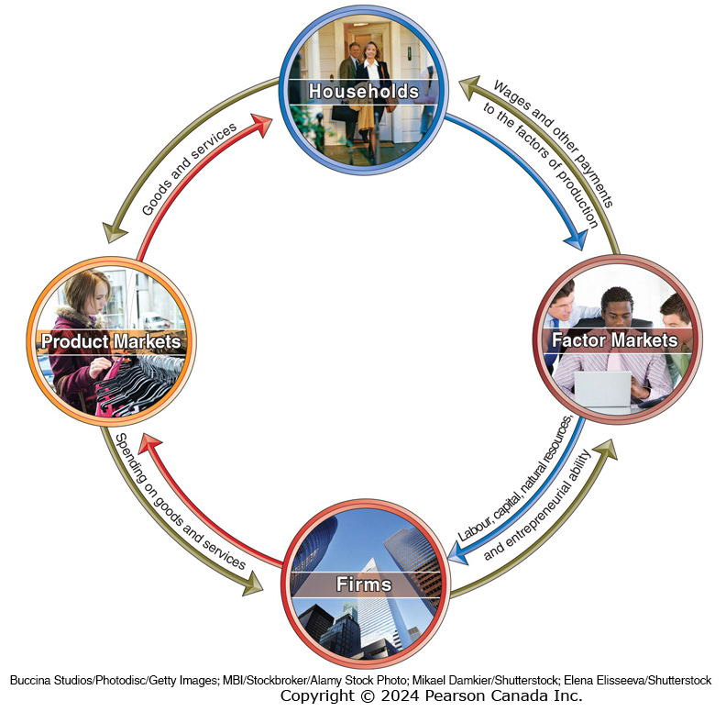
Figure 2.6 The Circular-Flow Diagram (1 of 2)
Circular-flow diagram: A model that illustrates how participants in markets are linked.
Households provide factors of production to firms.
Firms provide goods and services to households.
Firms pay money to households for the factors of production.
Households pay money to firms for the goods and services.

Slide 22
Figure 2.6 The Circular-Flow Diagram (2 of 2)
Like all economic models, the circular-flow diagram is a simplified version of reality:
No government
No financial system
No foreign buyers and sellers of goods
We will explore these sectors in later chapters.

Slide 23
The Gains from Free Markets
A free market is one with few government restrictions on how goods or services can be produced or sold, or on how factors of production can be employed.
Countries that come closest to the free market benchmark have been more successful than those with centrally planned economies in providing their people with rising living standards.
This concept is not new: Adam Smith argued for free markets in his 1776 treatise, An Inquiry into the Nature and Causes of the Wealth of Nations.
Adam Smith’s “invisible hand” allows individuals acting in their own self-interest to collectively end up satisfying the wants of consumers.

Slide 24
Things to Remember
The production possibilities frontier should never bow inward (why?).
The PPF tells us what can be produced, not what should be produced.
Just because someone is better or worse at everything, doesn’t mean trade with them cannot be beneficial.
The basis for trade is comparative advantage, not absolute advantage!
Free markets raise the standard of living; but that doesn’t mean there is no role for governments.
Governments must provide a sound legal environment to allow the market system to succeed.

